Slide 1
Introduction
to
Docker
Training - Session #1

Slide 2
Topics
What are Containers?
Benefits of Containers
What is Docker?
Docker - Architecture
Docker - Commands
DockerFile - Intro
DockerFile Scripting

Slide 3
What are containers?
Packaging a piece of your software
Stand-alone
Light-weight
Executable
Contains everything needed for the piece to run
Independent of Environment/ OS

Slide 4
Benefits of Containers
No one needs to know configuration
Standard packaging
Scaling
Repeatable
Focus on code than deployment
Runs here; runs everywhere
Costs less
Run multiple version of softwares

Slide 5
What is Docker?
Concept started by - Chroot, LXC, etc
COntainer Management Solution by docker.com
Enterprise Edition
Community Edition
Written on Go
Virtualization done over OS (not over h/w like VM does)
Available for Linux, Windows, Mac
Growing Community and new features released quickly
Notes:
A chroot on Unix operating systems is an operation that changes the apparent root directory for the current running process and its children. A program that is run in such a modified environment cannot name (and therefore normally cannot access) files outside the designated directory tree.
A chroot jail is a way to isolate a process from the rest of the system. It should only be used for processes that don't run as root, as root users can break out of the jailvery easily. The idea is that you create a directory tree where you copy or link in all the system files needed for a process to run
LXC is the well known set of tools, templates, library and language bindings. It's pretty low level, very flexible and covers just about every containment feature supported by the upstream kernel.

Slide 6
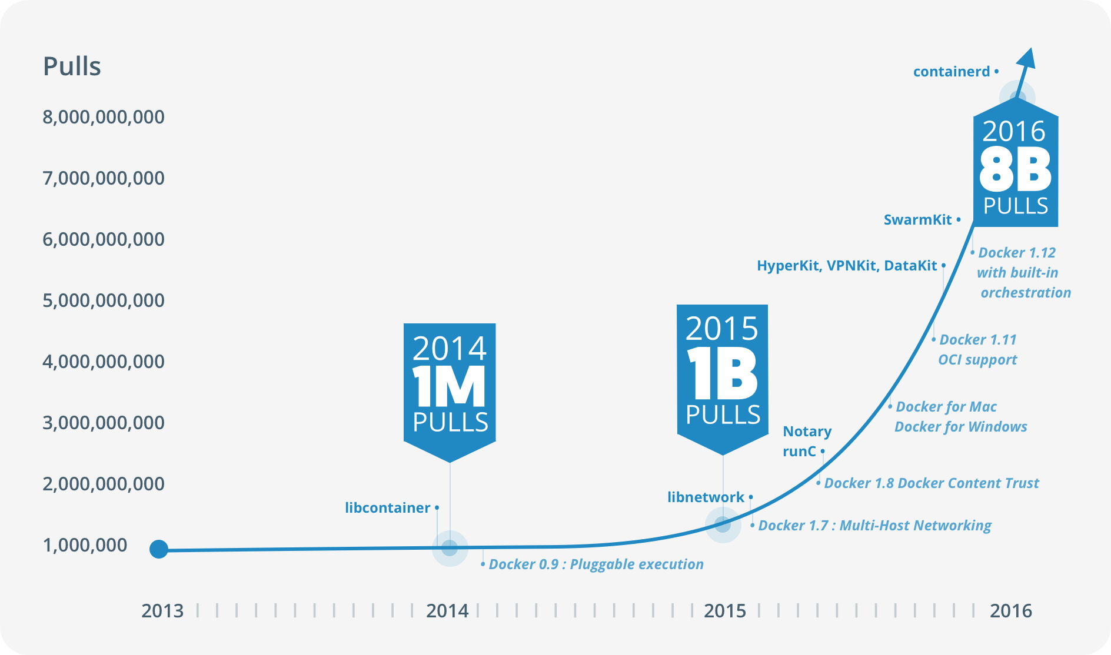
What is Docker?

Slide 7
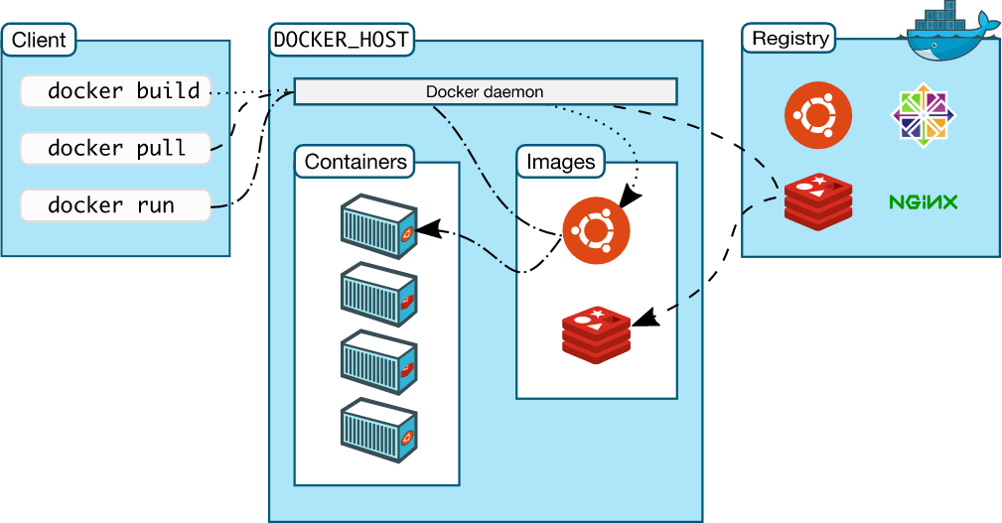
Docker Architecture

Slide 8
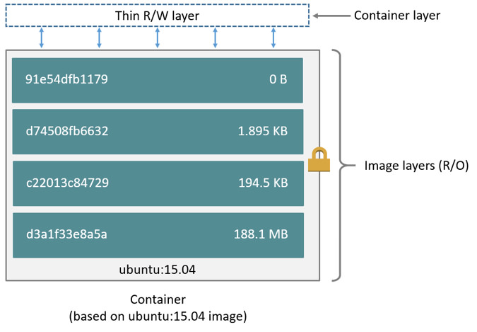
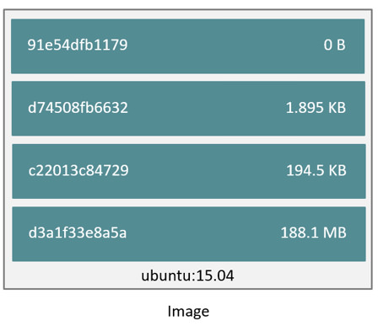
Docker Architecture - Images & Containers
Read only layers
Layers are Diff
Copy on Write

Slide 9
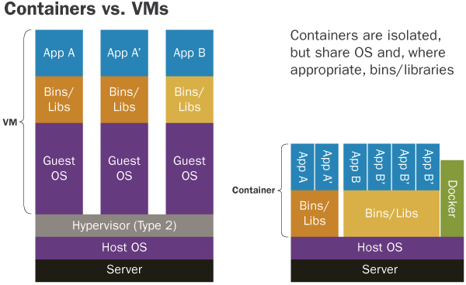
Containers Vs Virtual Machines

Slide 10
Docker - Commands
https://docs.docker.com/engine/reference/commandline/docker/#description
docker ps
docker version
docker history
docker images/ container
docker run/ kill/ start/ stop
docker rm/ rmi
….

Slide 11
Docker Commands - Run
docker run [OPTIONS] IMAGE [COMMAND] [ARG...]
Must know options
--name <name>
-p [IP optional]:<host port>:<container port>
-it, -i -t PseudoTTY
-v <host-dir>:<container-dir>
-e, --env, --env-file

Slide 12
Dockerfile
You can put all your instructions for the container in a file named “Dockerfile”
Build Images using “docker build”; push images to Registry
Run containers using “docker pull” for previously built images
Supporting Commands- docker pull, docker push, docker commit (used to commit running container’s state)

Slide 13
Dockerfile
docker build -f <path> -t <namespace/name:tag> .
File elements
Comments start with #
INSTRUCTION <argument>
FROM <image:tag>
MAINTAINER <name> (Deprecated now) use LABEL
COPY <src-location-host> <dest-location-container>
ADD <src> <dest>
EXPOSE <port1> <port2> <port3> ..
ENV <key> <value>
ARG <key> <value>
LABEL <key> <value>

Slide 14
Dockerfile
File elements
Instructions
VOLUME <name>
USER <name>
WORKDIR <path>
RUN <command>
CMD [“executable”, “parameter1”, “parameter2”, ..]

